Slide 1




An educational partnership among
Charlotte-Mecklenburg Schools, UNC Charlotte and Davidson College

Slide 2

The Yale National Initiative
Established in 1978 between Yale University and the New Haven Public Schools to strengthen teaching in public schools.
Includes a League of Teachers Institutes
  Charlotte
  New Haven
  Pittsburgh
  Philadelphia
  New Castle, Delaware
http://teachers.yale.edu/units/index.php?&skin=h

Slide 3
The Yale Teachers Institute Model
Teacher-Driven Organization
University and School Partnership
Content-Rich Seminars
Collaborative Seminar Environment
Creative, Innovative Curriculum Development
Local and National Seminars
Teachers Become Published Authors

Slide 4
Your Story
How you got involved
Types of Seminars
Experience in a Seminar
Writing a Curriculum Unit
Teaching a Curriculum Unit
Impact on Students
Impact on Teachers

Slide 5
CTI Fellows
Professional, innovative, and collaborative experiences for you and your students
Interact with a diverse range of CMS teachers
Teach your curriculum unit in your classroom
Publish your unit on the CTI and Yale National Initiative websites.
Develop the opportunity to get involved with additional leadership roles within CMS
Receive a $1,500 stipend paid by CMS and 3 CEU credits, upon completion of your curriculum unit

Slide 6
2014 CTI Local Seminars 1 of 2
Exercise and the Brain
Barbara Lom, Biology, Davidson College
What Makes a Nation?
Shelley Rigger, Political Science, Davidson College
The Origins of Human Language
Ron Lunsford, English, UNC Charlotte
Fundamentals of Mathematics
Harold Reiter, Mathematics and Statistics, UNC Charlotte

Slide 7
2014 CTI Local Seminars 2 of 2
Peace Education: Psychological Factors that Endorse War
Rick Gay, Educational Studies, Davidson College
Integrating Concepts in Life Sciences
Malcolm Campbell and Chris Paradise,
Biology, Davidson College
Africa: Moving Beyond Popular Culture
Beth Whitaker, Political Science, UNC Charlotte
Supernatural Figures in Theatre, Film and the Brain
Mark Pizzato, Theatre, UNC Charlotte

Slide 8
Calendar for CTI Fellows
February 26: 2015 Local Open House at UNC Charlotte Center City Building (9th and Brevard)
March 18: Applications Due
April 2: Applicants notified of decision
April 23: Fellows Orientation
April/May: Seminar Meetings Begin
(3 meetings)
September: Weekly Seminar Meetings Begin
December 10: CTI Fellows’ Finale Celebration

Slide 9
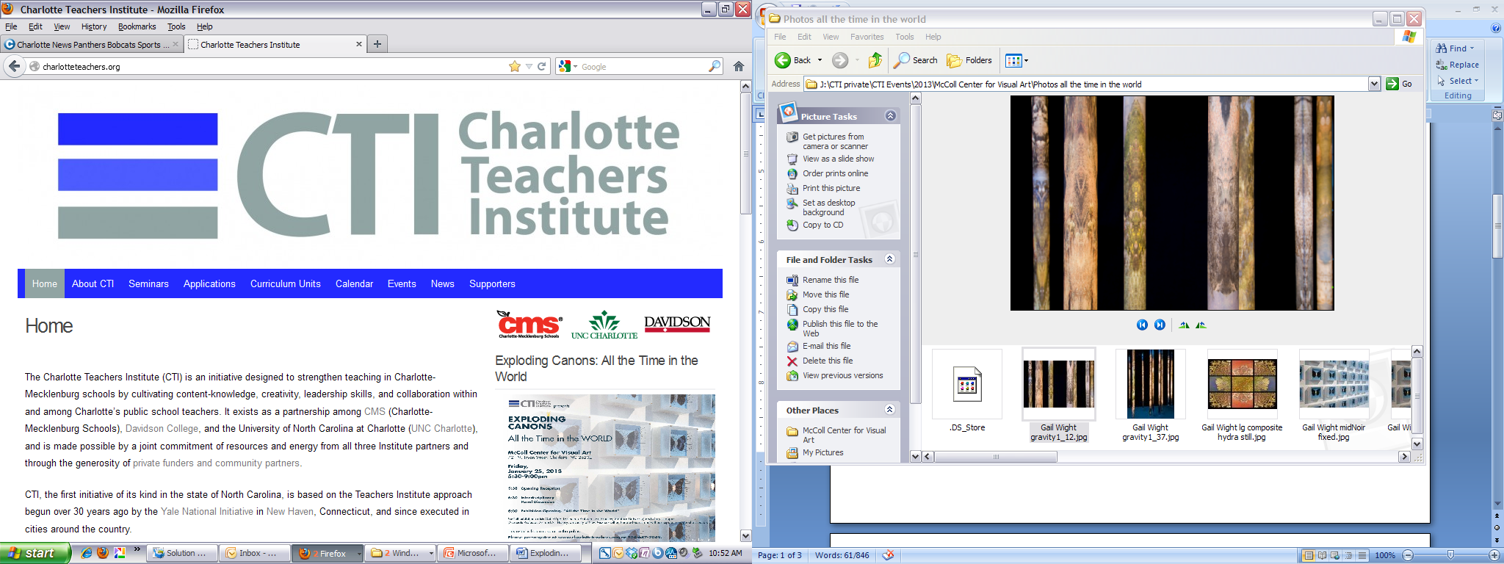

Slide 10
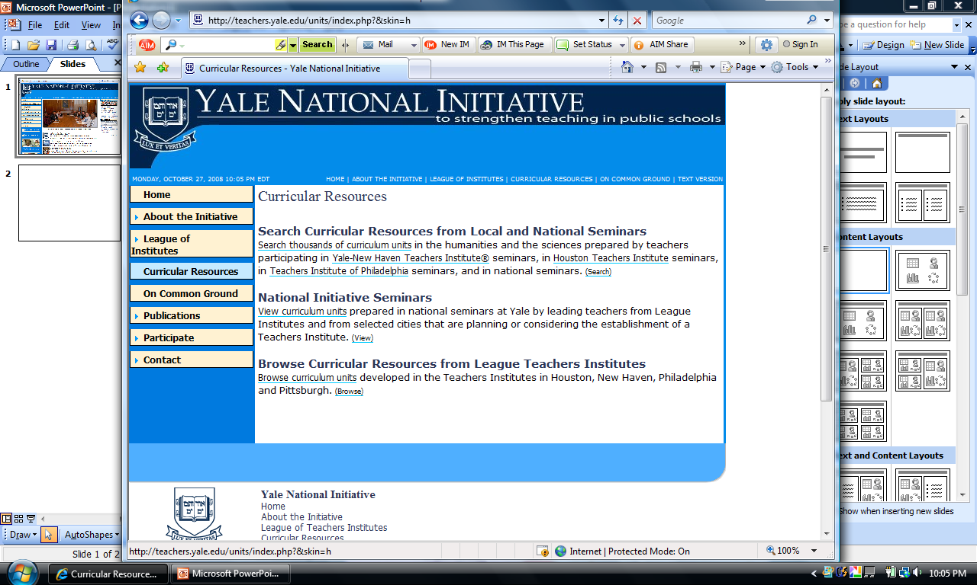

Slide 11
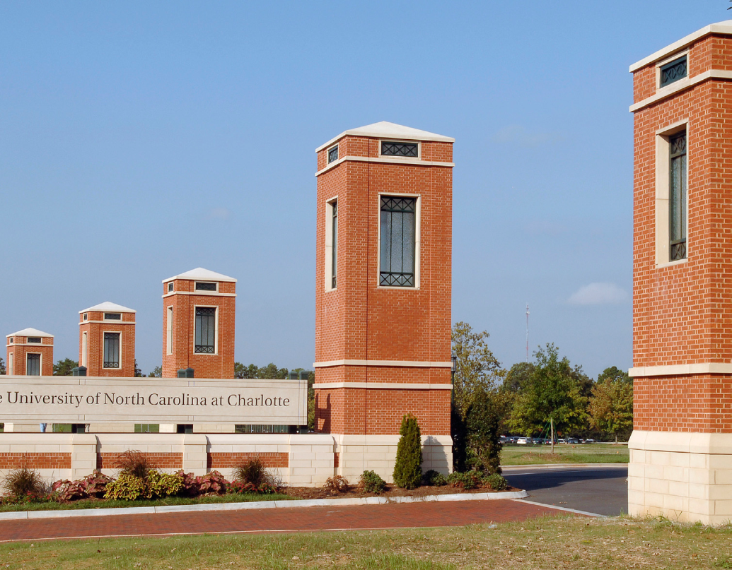
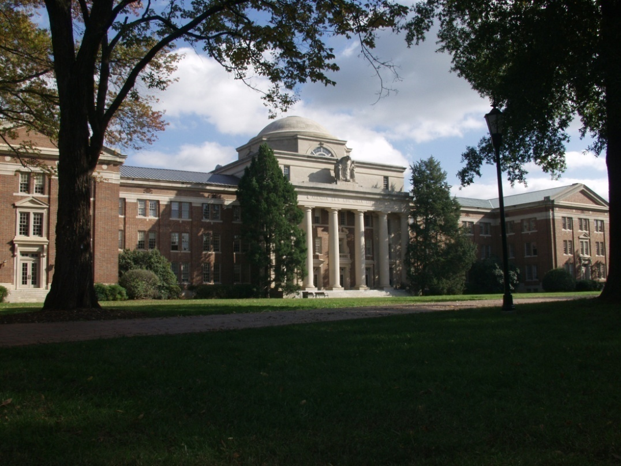
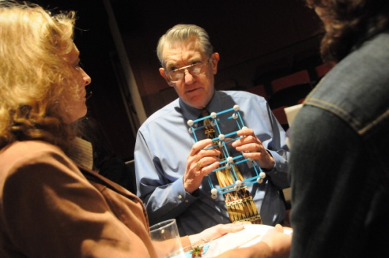
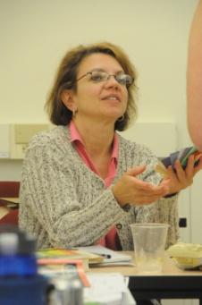
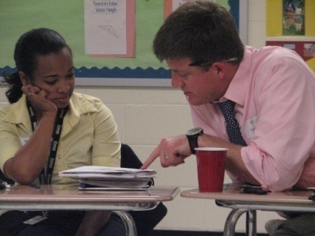
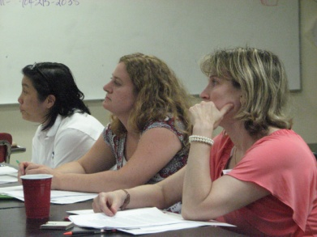
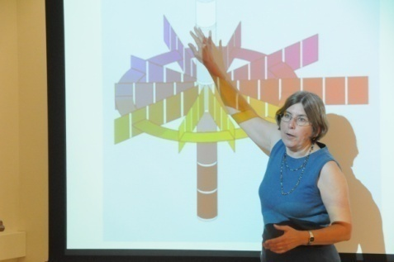
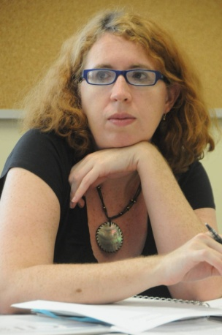
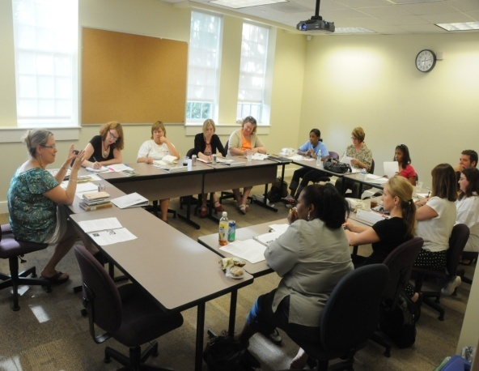
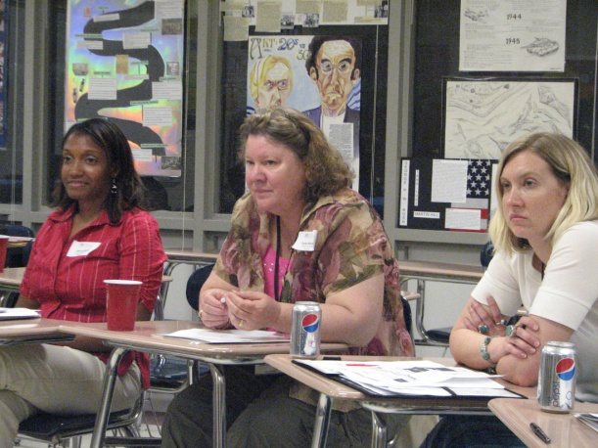
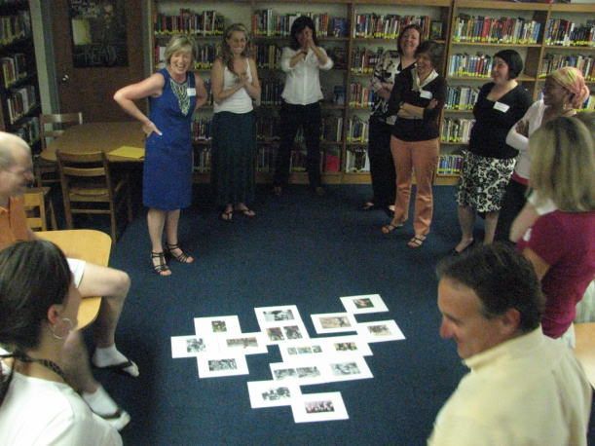

Slide 12
UNC Charlotte
324 Fretwell
Charlotte, NC 28223
Phone: 704·687·0078
Fax:704·687·0079
www.charlotteteachers.org

