Slide 1




CTI invites You to Participate in
Content-Rich Seminars led by Faculty from
Davidson College
UNC Charlotte

Slide 2
Agenda
      Welcome
      Handouts
      2014 Seminars
      Curriculum Units
      CTI Program & Application Process
      Calendar
Notes:
Thank teacher leaders
Introduce and thank faculty

Slide 3
Materials in Your Packet
      CTI Teacher Leaders (yellow)
      2014 Detailed Calendar (white)
      Application Review Policies (salmon)
      2014 CTI Participating Schools (blue)
      2014 Seminar Descriptions (green)
      Information Form (pink) – please complete and submit to CTI Teacher Leaders at end of tonight

Slide 4
2014 Seminars
UNC Charlotte
Heroes, Rebels and Rock Stars: Cultural Icons in Modern Europe
Seminar Leader: Heather Perry, Associate Professor, UNC Charlotte
Seminar Coordinator: Roshan Varghese, History, Butler High School
Intersections of Science, Technology, and Culture
Seminar Leader: Alan Rauch, Professor of English, UNC Charlotte
Seminar Coordinator: Jennifer Thompson, Science, James Martin Middle School
Metamorphosis: Transformative Experiences
Seminar Leader: Amy Ringwood, Associate Professor of Biology, UNC Charlotte
Seminar Coordinator: Mary Fabian, Science, Cato Middle College
Visual Storytelling in Children’s and YA Literature
Seminar Leader: Paula Connolly, Associate Professor of English, UNC Charlotte
Seminar Coordinator: Teresa Strohl, Visual Arts, Barringer Academic Center

Slide 5
2014 Seminars
At Davidson College
Artificial Intelligence
Seminar Leader: Raghuram Ramanujan, Assistant Professor of Mathematics, Davidson College
Coordinator: Phil Carver, Science, James Martin Middle School
Human Agency
Seminar Leader: Meghan Griffith, Associate Professor of Philosophy, Davidson College
Seminar Coordinator: Susan Jones, 1st Grade, Steele Creek Elementary School
The Global Energy Challenge
Seminar Leader: Durwin Striplin, Professor of Chemistry, Davidson College
Seminar Coordinator: DeNise Gerst, Science, Barringer Academic Center
The Art of Fiction: Close Analysis, Style, and the Novel
Seminar Leader: Maria Fackler, Assistant Professor of English, Davidson College
Seminar Coordinator: Jennifer Ladanyi, Language Arts, Bailey Middle School

Slide 14
Curriculum Units
15-25 pages; 3 drafts
Based on Seminar Topic
Includes:
  Background information about your school and the class(es) you plan to use for unit implementation
  Rationale for the unit
  Strategies for teaching the unit
  Short lessons for teaching the unit
  Readings you recommend to teachers and students (+ any appendices that you find valuable)
This unit is for your class AND it is published: charlotteteachers.org/curriculum.html
Not to worry…there is plenty of help available from veteran Fellows and Coordinators.

Slide 15
Seminars are…
Collaborative
Collegial
A Commitment
    - Fellows must attend all Seminar Meetings
    - Fellows must complete a curriculum unit
Rewarding
    - Long-term relationships
    - New curriculum
    - Leadership skills
    - $1,500 stipend and 3 CEUs
    - Opportunity to apply to National Summer Seminars at Yale University

Slide 16
Calendar for 2014 CTI Fellows
  March 12: Applications due
  April 1: Fellows notified of their selection via email
  April 24: Orientation (at Discovery Place)
  April-May: 3 seminar meetings plus Campus Connection events
  June 13: Curriculum unit Prospectus due
  July-August: Reading Period
  August: 1:1 meetings with your Seminar Leader
  September-November: Weekly seminar meetings (Thursday evenings)
  December 11: Fellows’ Finale!

Slide 17
Application
  Online (http://apps.charlotteteachers.org/)
  Login (previous applicants) or create account (new applicants)
    Check to be sure your school and principal are shown correctly
  Read the directions
    Create all essays in word document and paste into application
    Save as you go (“Save”)
  Complete application
  Focus on your curriculum idea
    Many ways to demonstrate leadership
    Consider applying to more than one seminar
  Submit application (“Submit”)
  Let your principal know you have applied
  Contact CTI Teacher Leaders with questions

Slide 18
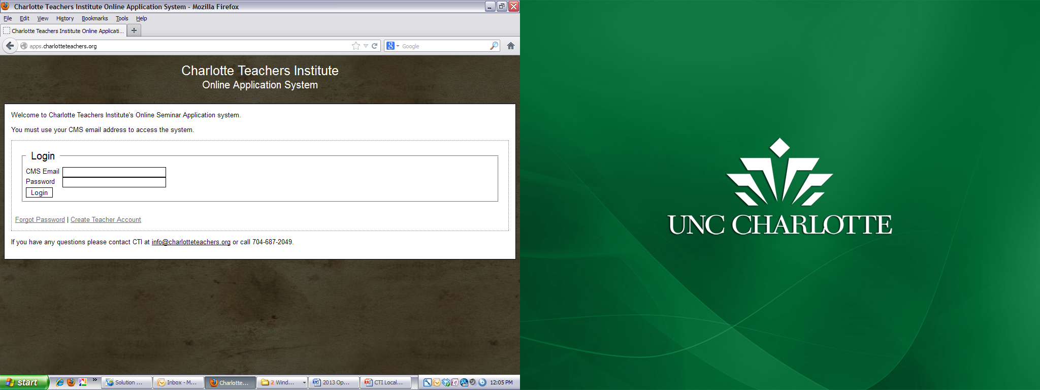

Slide 19
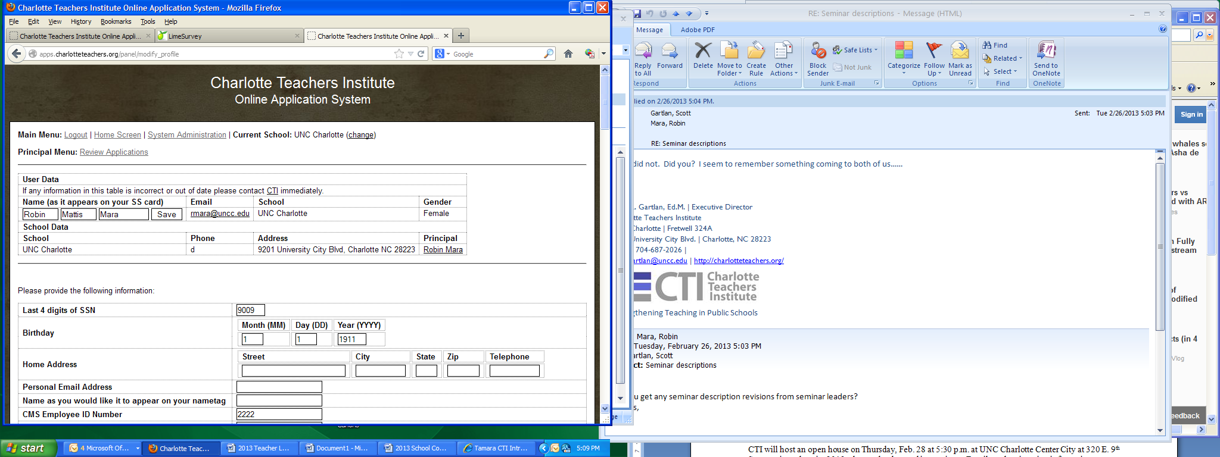

Slide 20
For those interested…
  Check the Calendar – make sure ALL dates work for you
  Submit Online Application by March 12
  (contact Teacher Leaders with questions)
  Submit pink information sheets tonight

Slide 21
CTI invites You to Participate in
Content-Rich Seminars led by Faculty from
Davidson College
UNC Charlotte

